Slide 1
Abstract Art
Mr. Richter's Class

Slide 2
Abstract Art
Abstract art uses a visual language of form, color and line to create a composition which may exist with a degree of independence from visual references in the world. Western art had been, from the Renaissance up to the middle of the 19th century, underpinned by the logic of perspective and an attempt to reproduce an illusion of visible reality.

Slide 3
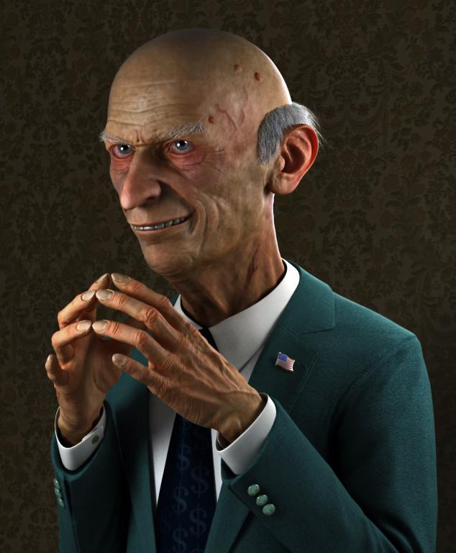
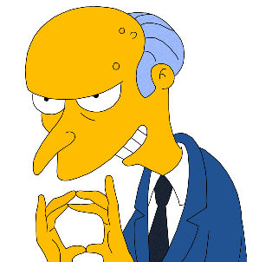
Representationalism
Is art creations that represent objects from real life. There are varying degrees of representation.

Slide 4
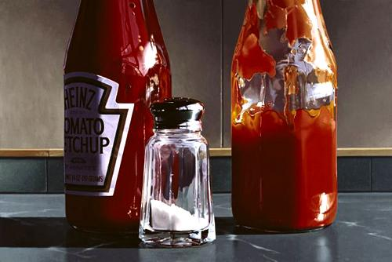
Photorealism
One of the degrees of representationalism is photorealism. (Ralph Goings)

Slide 5
Elements of Art
Color
Shape
Form
Space
Line
Texture
Value
These Elements are
very important in most all of Abstract Art
These Elements tend to be a little less prominent in Abstract Art

Slide 6
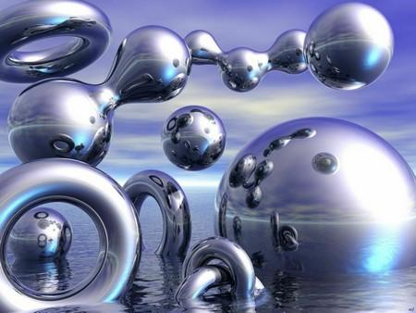
Elements of Abstract Art
Form is an element of art. At its most basic, a form is a three dimensional geometrical figure (ex: sphere, cube, cylinder, cone), as opposed to a shape, which is two dimensional, or flat.

Slide 7
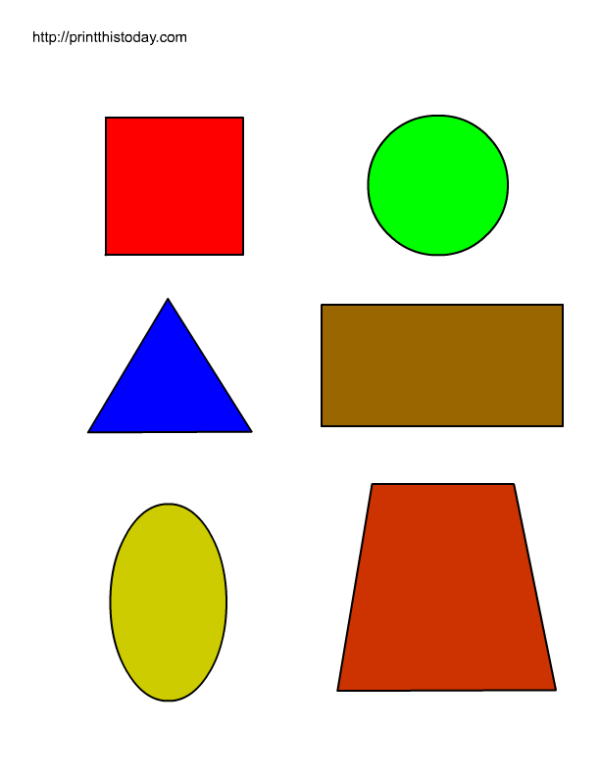
Elements of Abstract Art
Shape pertains to the use of areas in two dimensional space that can be defined by edges, setting one flat specific space apart from another. Shapes can be geometric (e.g.: square, circle, hexagon, etc.) or organic (such as the shape of a puddle, blob, leaf, boomerang, etc.)

Slide 8
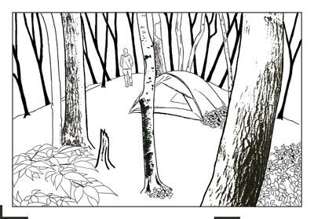
Elements of Abstract Art
Line is defined as a mark that spans a distance between two points (or the path of a moving point), taking any form along the way. As an art element, line pertains to the use of various marks, outlines and implied lines in artwork and design, most often used to define shape in two-dimensional work.

Slide 9
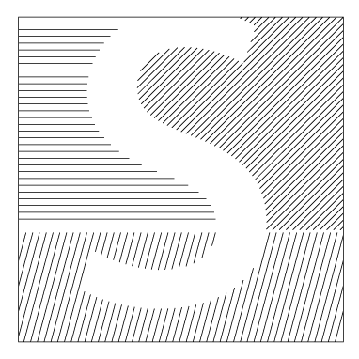
Line, continued...
Implied line is the path that the viewer's eye takes as it follows shapes, colors, and form along a path, but may not be continuous or physically connected, such as the line created by a dancer's arms, torso, and legs when performing an arabesque. Line is an element of art that is simplest, most ancient, and most universal means for creating visual arts.

Slide 10
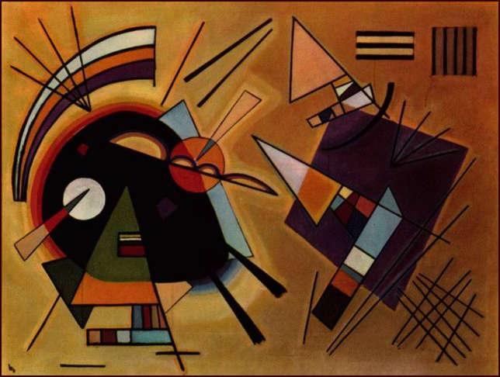
Abstract Art Examples
Wassily Kandinsky

Slide 11
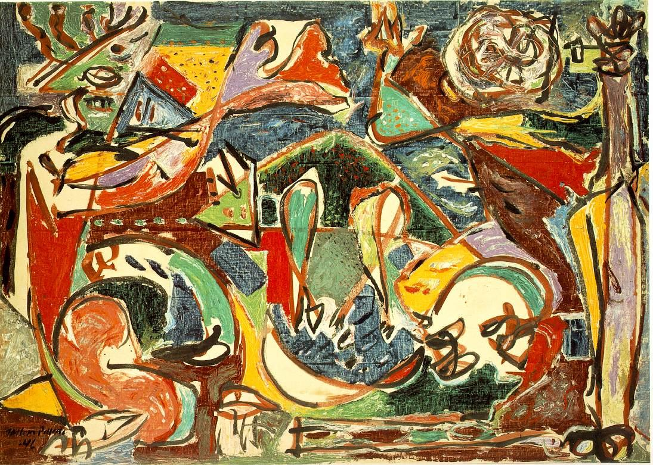
Abstract Art Examples
Jackson Pollock

Slide 12
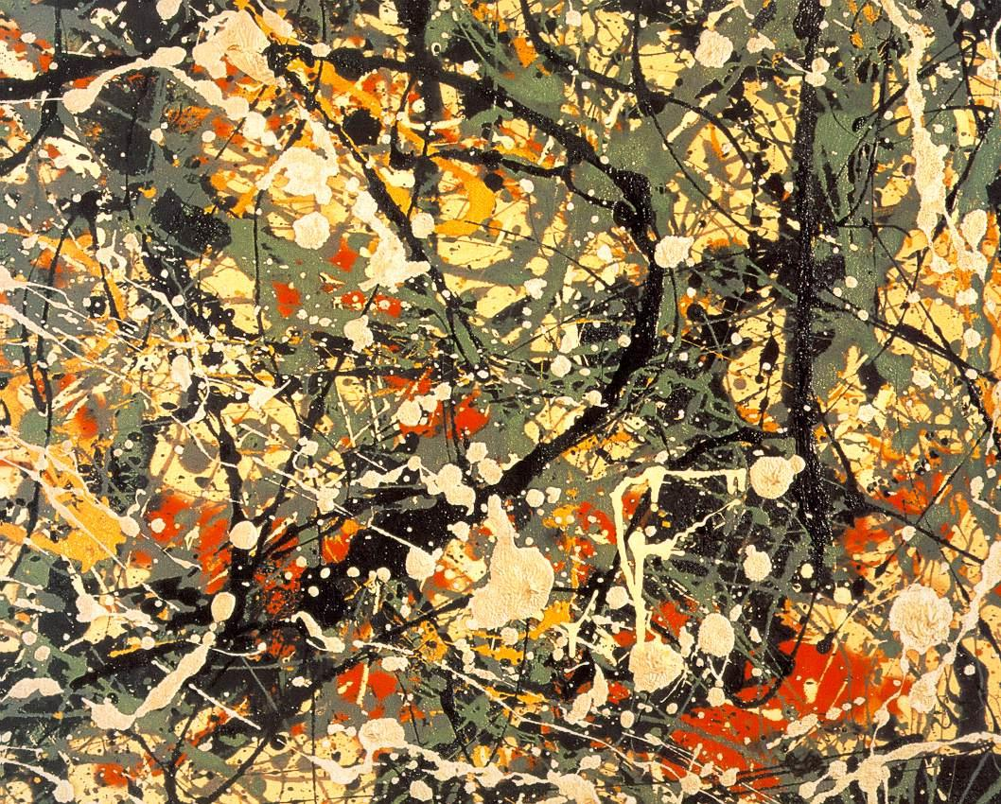
Abstract Art Examples
Jackson Pollock

Slide 13
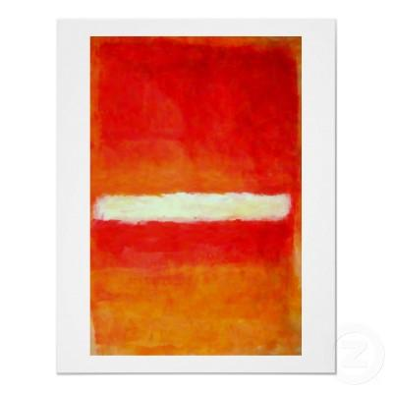
Abstract Art Examples
Mark Rothko

Slide 14
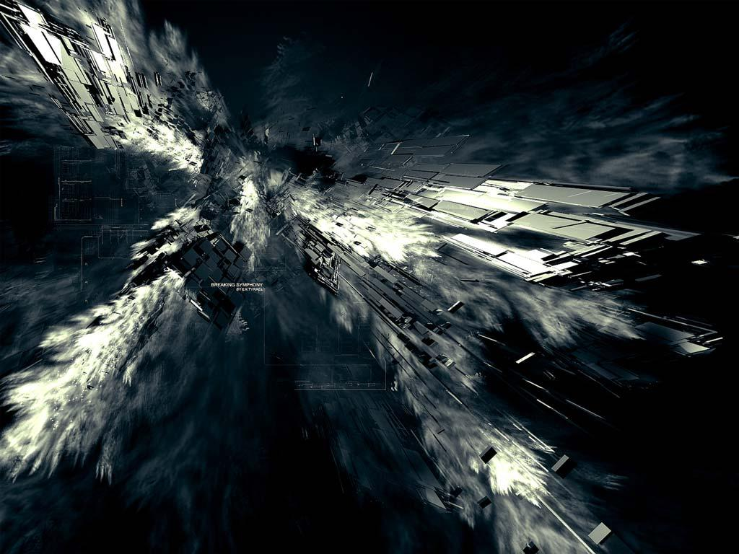
Abstract Art Examples
Digital Art

Slide 15
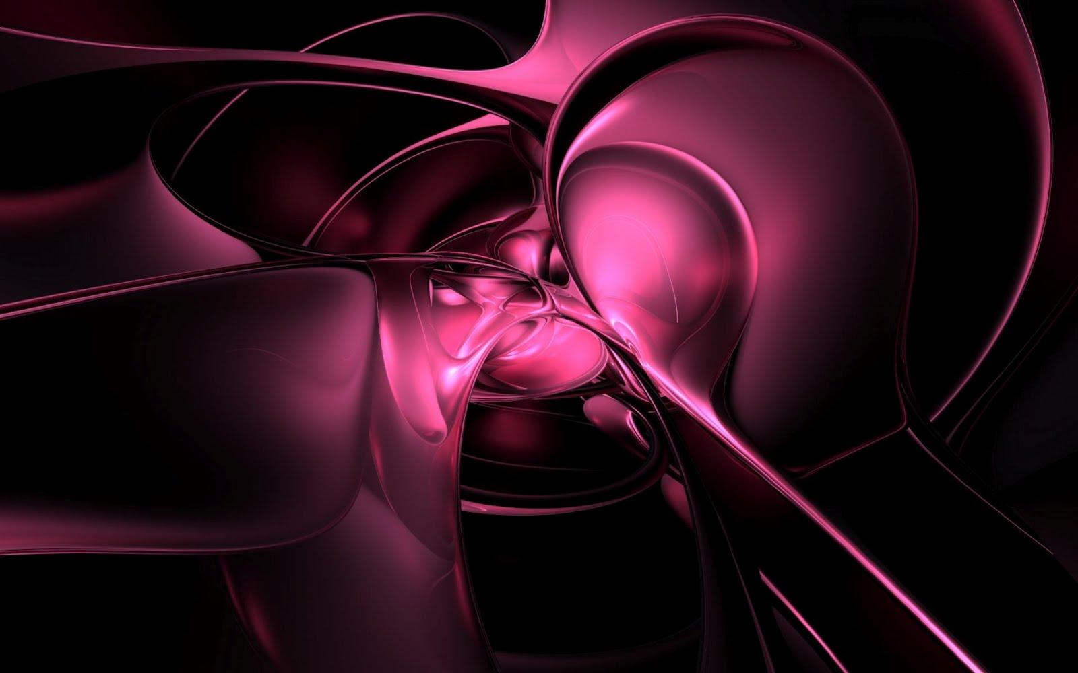
Abstract Art Examples
Digital Art

Slide 16
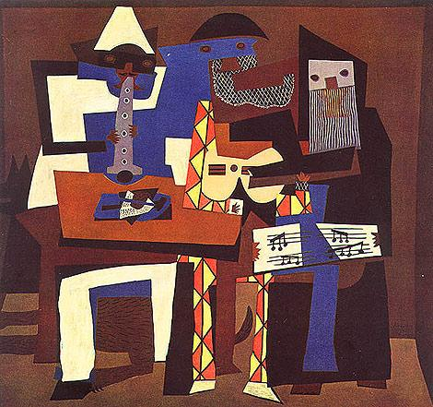
Abstract Art: Cubism
Pablo Picasso

Slide 17
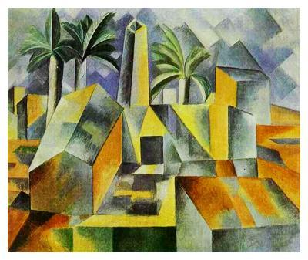
Abstract Art: Cubism
Pablo Picasso

Slide 18
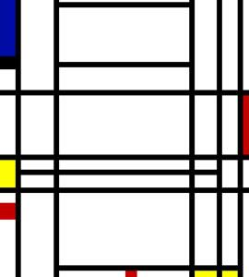
Geometric Abstract Art
Mondrian

Slide 19
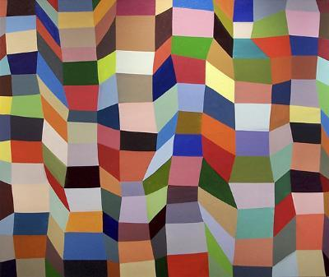
Geometric Abstract Art
Kevin Bean

